Slide 1





Building Distributed Systems with MQTT
2022/11/09
François Normandin
Certified LabVIEW Architect
LabVIEW Champion
https://www.linkedin.com/in/francois-normandin
https://github.com/francois-normandin

Slide 2
Outline
Distributed Systems
MQTT Protocol
Demos of a distributed system components
Data producer, Data consumer
Service, Streaming
Redirection, Hierarchical Systems
Conclusion
Does MQTT fulfill the requirements for Distributed Systems?

Slide 3


Open Source Enthusiast
24 open source VI Packages on vipm.io
35+ public repositories on github.com
(MQTT, Oauth2, OpenSerializer, URI, Epoch-Time, Cron, UI Tools, etc.)
Board member at GCentral
Enabling the LabVIEW community to make the best version of itself.
Improving our community's capability by removing barriers to collaboration.
Maintainer of JKI’s Caraya Unit Test framework
Maintainer of JKI’s State Machine Objects framework

Slide 4


Distributed Systems
A distributed system is any composition of individual entities performing independently of each other, that can achieve emergent functions when put together.
System

Slide 5
Ideal properties
Entities are uniquely addressable
Entities perform asynchronously
Entities can be stateful
Entities can be hierarchical
Communication has low-latency
Communication can be secured
Entities are interoperable
Entities are testable
Entities are debuggable and traceable
System

Slide 6
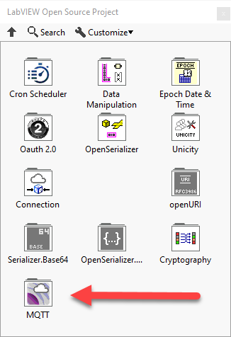

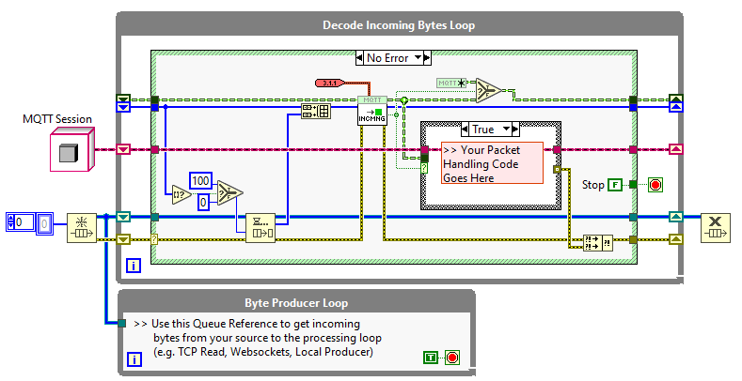

MQTT Protocol
Small Control Packets (much smaller than HTTP requests)
Publish-Subscribe Protocol
TCP, WS (any guaranteed/ordered delivery protocol)
Client is very lightweight
Low-latency

Slide 7
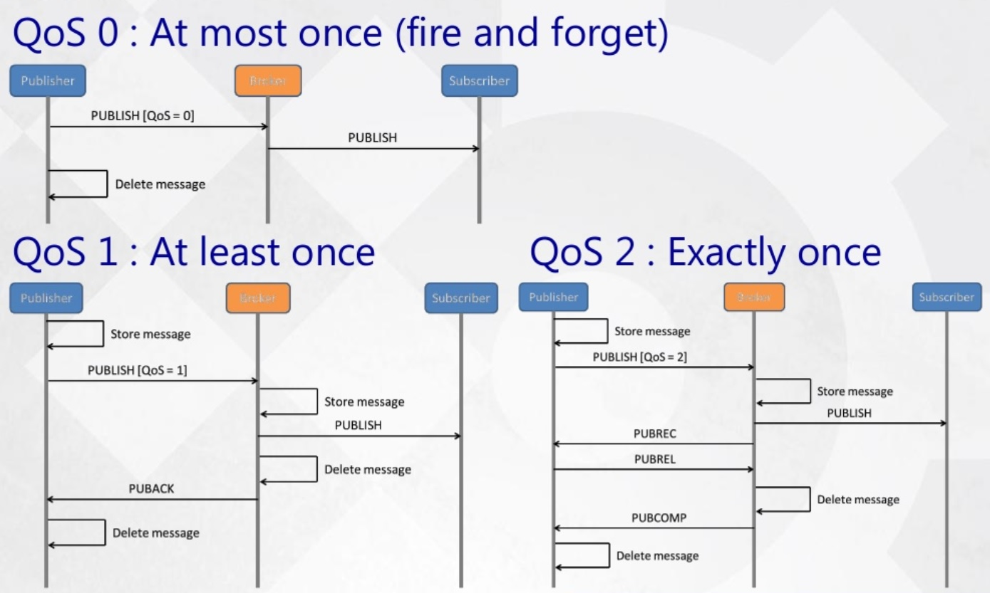
QoS Example
Setup: Broker + Two Clients (Publisher’s perspective with QoS = 0 Subscriber)
Credit: https://devopedia.org/mqtt

Slide 8
References
MQTT 3.1.1 Specification
http://docs.oasis-open.org/mqtt/mqtt/v3.1.1/mqtt-v3.1.1.html
LabVIEW Open Source Project
https://github.com/LabVIEW-Open-Source/LV-MQTT-Broker
NIWeek 2019: Message Exchange Patterns and Tools for Distributed Systems
https://labviewwiki.org/wiki/NIWeek_2019/Message_Exchange_Patterns_and_Tools_for_Distributed_Systems
UK Tag #7
https://github.com/francois-normandin/mqtt-lv-py-demo
Short videos on Youtube
MQTT Broker in LabVIEW: https://youtu.be/Y-jrwyfD9DU
TLS Secured MQTT: https://youtu.be/2-OJ-U6eTmE

Slide 9
Demos
Functions | Messaging Pattern | Examples
Data Producer | Publish | Sensor
Data Consumer | Subscribe | View
Service | Request/reply | Instrument (HAL)
Streaming | Protocol Upgrade | 1:1 high speed
Redirection | Routing, delegation | MAL
Hierarchical System | Mixed | Test/Control System

Slide 10
Conclusion
Why use MQTT for Distributed Systems
Low-overhead protocol, TLS
Interoperability, dynamic topology, scalable
Distributable, asynchronicity
Debuggability, Testability

Slide 11
THANK YOU ALL
Question? Suggestions? Want to know more?
https://github.com/francois-normandin/mlug-2022-11-09
Or look for these short videos on Youtube!
MQTT Broker in LabVIEW: https://youtu.be/Y-jrwyfD9DU
TLS Secured MQTT: https://youtu.be/2-OJ-U6eTmE
François Normandin
Certified LabVIEW Architect
LabVIEW Champion
https://www.linkedin.com/in/francois-normandin
https://github.com/francois-normandin

